Slide 1

Pradhan Mantri Rojgar Protsahan Yojana &
ECR 2.0 briefing 30/11/16
Employees’ Provident Fund Organization
(A Statutory Body under Ministry of Labor & Employment, Govt. of India)
Pradhan Mantri Rojgar Protsahan Yojana &
ECR 2.0 briefing 30/11/16
Presentation By:
Regional Office, Ahmedabad

Slide 2

PMRPY an Introduction.
Pradhan Mantri Rojgar Protsahan Yojana &
ECR 2.0 briefing 30/11/16
The PRADHAN MANTRI ROJGAR PROTSAHAN YOJANA (PMRPY) plan scheme has been designed to incentivize employers for generation of new employment, where Government of India will be paying the 8.33% EPS contribution of the employer for the new employment for three years. The scheme has a dual benefit, where, on the one hand, the employer is incentivized for increasing the employment base of workers in the establishment and on the other hand, a large number of workers will find jobs in such establishments. A direct benefit is that these workers will have access to social security benefits of the organized sector.

Slide 3
Eligibility of Establishment
Pradhan Mantri Rojgar Protsahan Yojana &
ECR 2.0 briefing 30/11/16
The establishment should be registered with EPFO under EPF ACT 1952 and should have a valid LIN number.
The establishment should have submitted their ECR for Mar-16.
The establishment should have increased the number of employees on or after 01/04/16.
For new establishments registered after 01/04/16, all new employees can avail benefits subject to their eligibility.

Slide 4
Eligibility of Employees
Pradhan Mantri Rojgar Protsahan Yojana &
ECR 2.0 briefing 30/11/16
The new employee should have joined the establishment on or after 01/04/16 and should not have been a regular employee in any EPF registered establishment prior to this.
The new employee should have a valid UAN which is Aadhaar linked.
The monthly wages of the new employee should be less than Rs. 15000.
EPS contribution for the new employee will be available for 3 years.

Slide 5
PMRPY reference base
Pradhan Mantri Rojgar Protsahan Yojana &
ECR 2.0 briefing 30/11/16
The reference base is taken as number of employees for whom the employer has deposited/filed the employer’s contribution of 12%(3.67% epf+8.33%eps) of wages with EPFO and is taken from the ECR return filed by employer as on 31st Mar-2016. Similarly for 2017-18 the reference base will be 31st Mar-2017 and so on for subsequent years.
In case of new establishments getting registered with EPFO after 01/04/16 the reference base will be taken as nil/zero and all new employees will be eligible to be covered under the scheme subject to other eligibility conditions.
The employer will not be eligible to avail PMRPY benefits if there is no new employment vis-à-vis the reference base in any subsequent month.

Slide 6
UAN Version 2.0
Pradhan Mantri Rojgar Protsahan Yojana &
ECR 2.0 briefing 30/11/16
Workflow for revised process of UAN generation and linking under the revised version of UAN
Introduction:The revised process of UAN generation and linking is based on the following principles:
The Electronic Challan cum Return would be UAN based.
The UAN in respect of member with first time employment would be generated by the employer prior to filing of ECR by employer for that member.
Also the linking of the existing UAN of the member with the present employment would necessarily be done by the employer before filing of UAN based ECR.
The member details i.e. name of member, date of birth, father’s/ Husband’s name etc. would be same for all the employments, since the details would be fetched from UAN database of member.

Slide 7
First time employment
Pradhan Mantri Rojgar Protsahan Yojana &
ECR 2.0 briefing 30/11/16
Based on above principles, the process of generation of UAN and linking employment has been revised as under:
A)The member has joined EPF for the first time: In such a case, the employer can obtain UAN upfront from EPFO portal on the basis of information furnished by the member in the declaration form. The employer can submit ECR in respect of this member only after the UAN has been obtained from the portal. The process flow is as follows:
The employer would obtain the Universal Account Number (UAN) for first time member from EPFO through an online functionality on the portal.
The employer is required to furnish the details of member i.e. member’s name, father’s/husband’s name, date of birth, date of joining and his KYC details on the portal.

Slide 8
First time employment Contd….
Pradhan Mantri Rojgar Protsahan Yojana &
ECR 2.0 briefing 30/11/16
The employer should furnish the member details on the basis of KYC document - Aadhaar to avoid future complications about member’s name, name of father/spouse, date of birth, gender etc.
The employer would get UAN from the portal and the same would be available for validation for the ECR file of the employer.
It is reiterated that this process is mandatory for the employer to include the new members in the ECR.

Slide 9
Prior member joining present employment
Pradhan Mantri Rojgar Protsahan Yojana &
ECR 2.0 briefing 30/11/16
The member was earlier member of EPF prior to joining the present establishment: In such cases, the process has been revised as follows:
The member declares the UAN/ EPF Account Number details to the employer through declaration form as per the existing process.
The employer is required to link the present employment with the provided Universal Account Number before filing ECR.
The member details as available in the provided UAN would be used in the ECR of the present employment.
The employer can start remitting dues through ECR for this linked UAN.

Slide 10
Process flow
Pradhan Mantri Rojgar Protsahan Yojana &
ECR 2.0 briefing 30/11/16
This can be done through individual or bulk mode.
On log-in by the employer, the following screen would appear.
Individual registration:For registration of member for UAN generation or linking, click on “REGISTER – INDIVIDUAL” under the menu tab “Member”.
Registration of member for UAN generation or linking
On clicking “REGISTER – INDIVIDUAL”, the Member Registration form will look as below and by default, Previous Employment option would be “No”, which is valid for all first time employment cases. For members with previous employment, the option has to be changed to “Yes”.

Slide 11
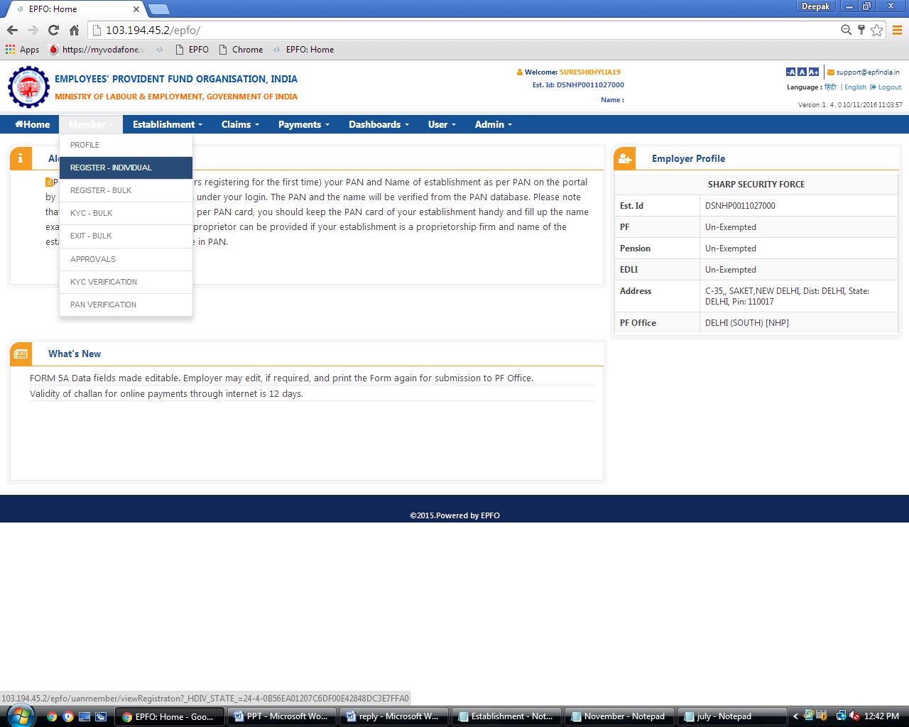

Slide 12
Why ECR II
Pradhan Mantri Rojgar Protsahan Yojana &
ECR 2.0 briefing 30/11/16
To ensure that the format is simplified and the details wanted in exceptional cases or one time are not part of the regular return.
Need to ensure that for want of the basic details of the members their benefit delivery does not suffer.
To ensure that the employer does not have to do the same work again.
To reduce the common mistakes in the return.
To ensure that the minimum data required to check the correctness of the uploaded return is available with EPFO.
.

Slide 13
ECR II
Pradhan Mantri Rojgar Protsahan Yojana &
ECR 2.0 briefing 30/11/16
The ECR II regular monthly file format will have 11 data fields reduced from 25, they are as follows:
1)UAN
2)Name of member
3)Gross wages
4)EPF Wages
5)EPS Wages
6)EDLI Wages
7)Employee share being remitted
8)Employer share being remitted
9)Pension Fund Contribution
10)Refunds
11)Non Contributory Period of Service

Slide 15
Thank You
Vigilance Awareness Week 31.10.2016 to 04.01.2016 Seminar

